Slide 1
Git Basic

Slide 2
Outline
Overview
GIT command
Insight GIT
Branch strategies
Note

Slide 3
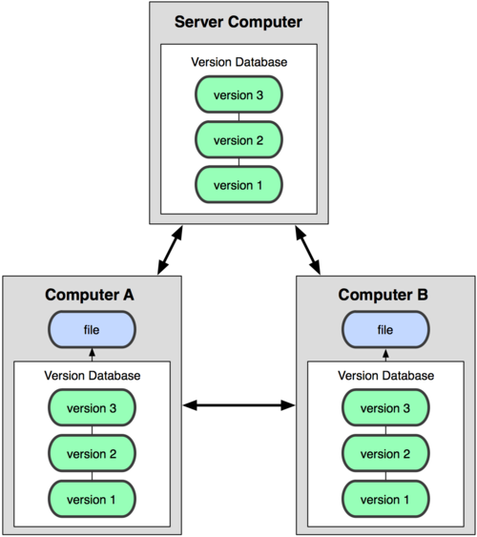
Overview
+ Distributed Version Control Systems

Slide 4
Overview
Term | Definition
Repository | Kho chứa mã nguồn cùng lịch sử thay đổi
Branch | Mỗi nhánh gắn liền với một ngữ cảnh
Tag | Đánh dấu một nhánh để dễ nhớ, so sánh
Commit | Xác nhận, cập nhật thay đổi vào repository
Merge | Trộn

Slide 5
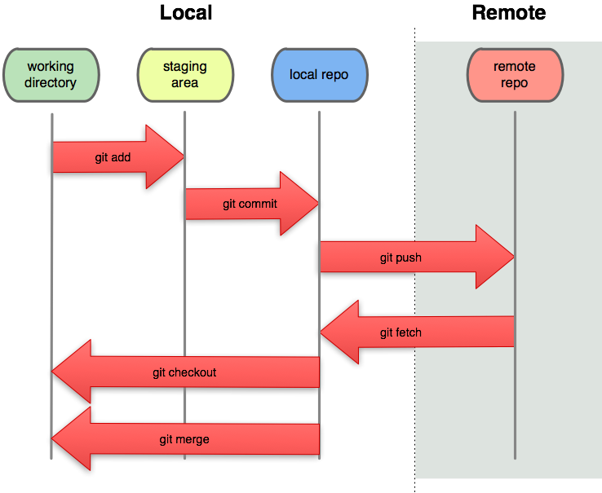
Overview
Everything is local
- working directory = one version of the project
- local repo = metadata + object database
- staging area(or index) = control what parts of working directory tree to go into the repository on the next commit operation

Slide 6
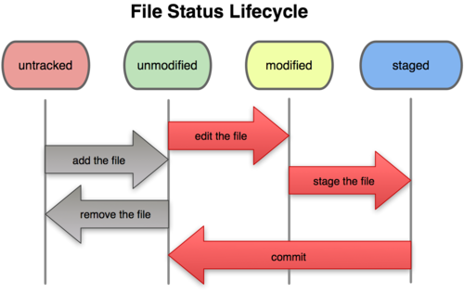
Overview

Slide 7
GIT command
Tell git who you are
  $ git config --global user.name "Your Name Comes Here"
  $ git config --global user.email you@yourdomain.example.com
Create new project
  git init
  git add .
  git commit
Making changes
  Edit file
  git add file1 file2 ….
  git diff –cached
  git status
  git commit

Slide 8
GIT command
Viewing project history
  git log
  git log –stat –summary
Managing branches
  git branch experimental (create branch)
  git branch (list branch)
  git checkout experimental ( switch to branch)
  git merge experimental (merge branch change)

Slide 9
GIT command
git clone url (get remote repository)
git pull url (origin) (fetch remote repository change and merge to local branch)
git fetch url (fetch remote repository change only)
git push url (push your change to remote repository)

Slide 10
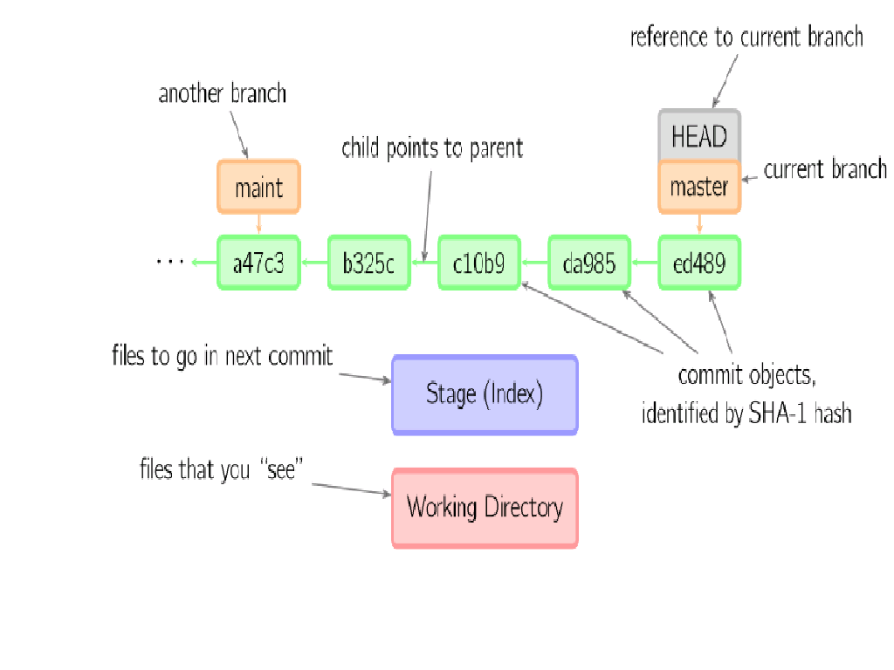
GIT command

Slide 11
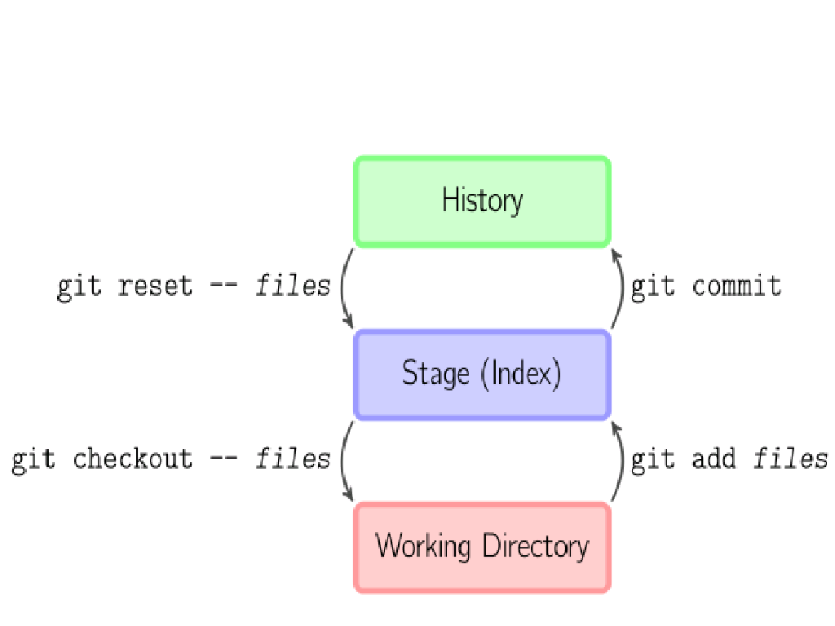
GIT command
Git add --files copies files to the stage
Git commit save snapshot of the stage as a commit
Git reset –files unstages files, equivalent “undo” git add, git-reset to unstage everything, if have –-hard flag, git will delete newer commit from it
Git reset –-hard 78bcd
Git checkout –files copies files from stage to working directory

Slide 12
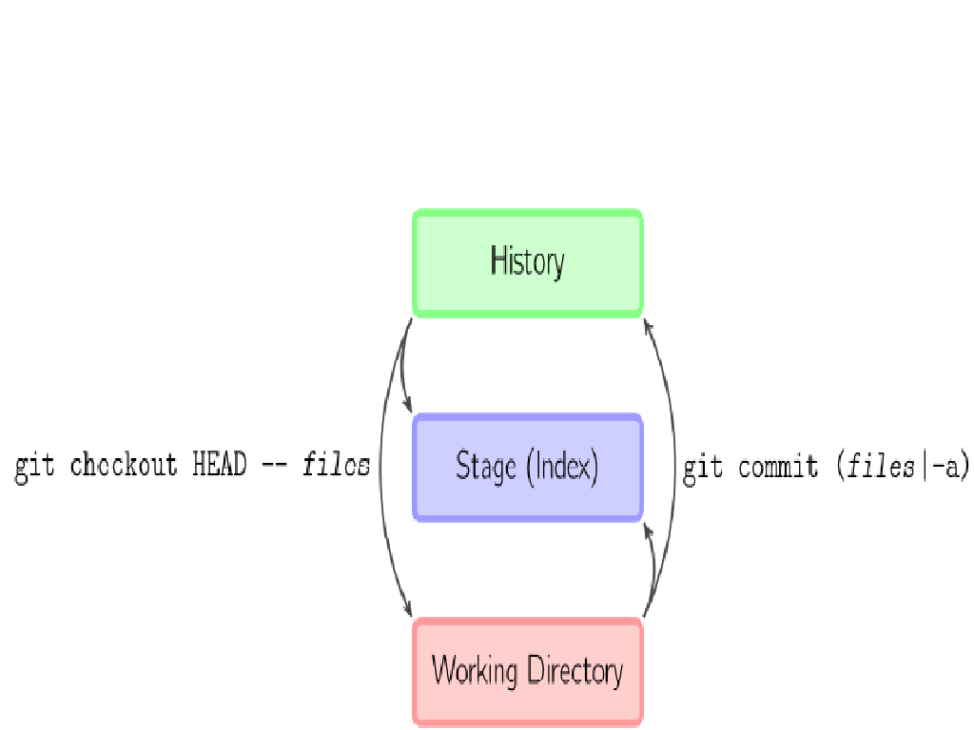
GIT command

Slide 13
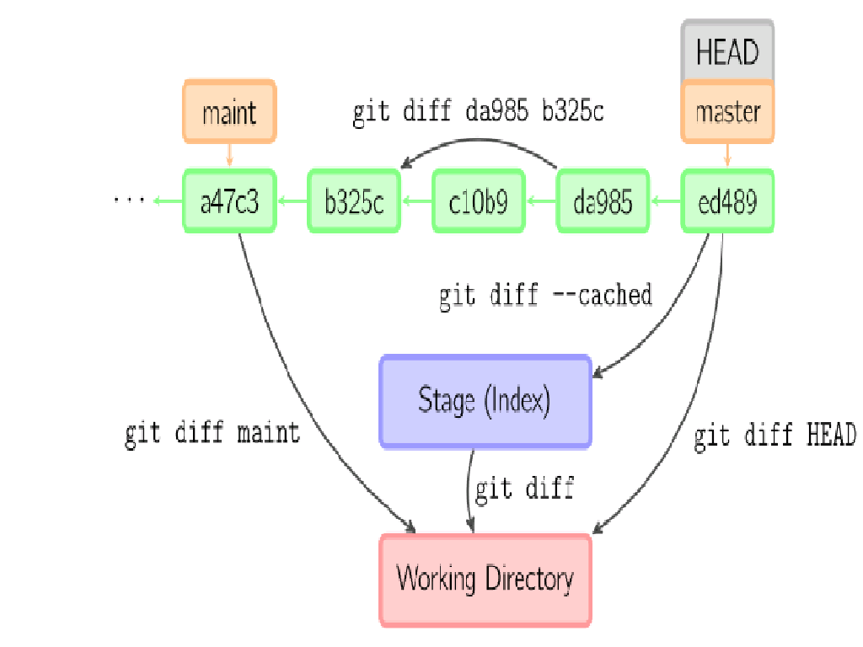
GIT command
Git diff can create patch file, we can use it for apply patch
$ git diff B A | git apply

Slide 14
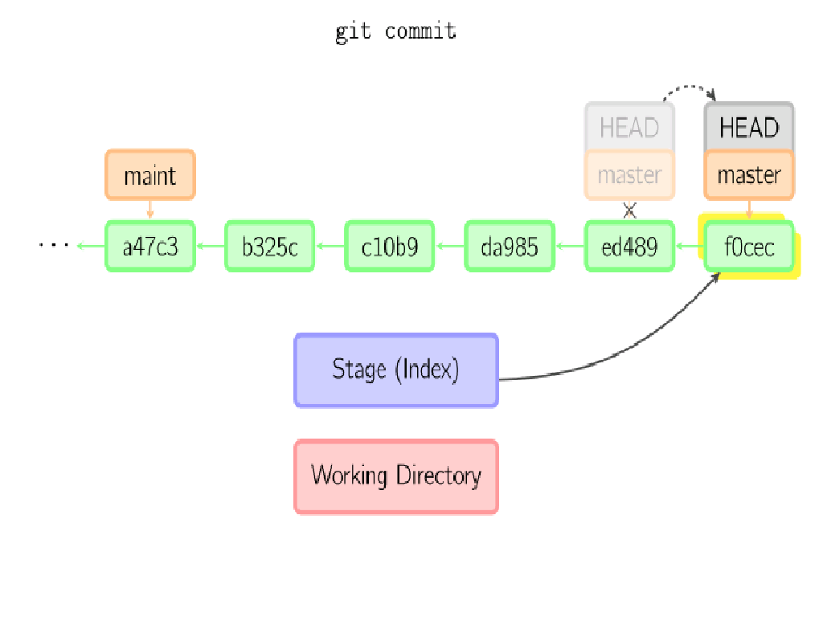
GIT command

Slide 15
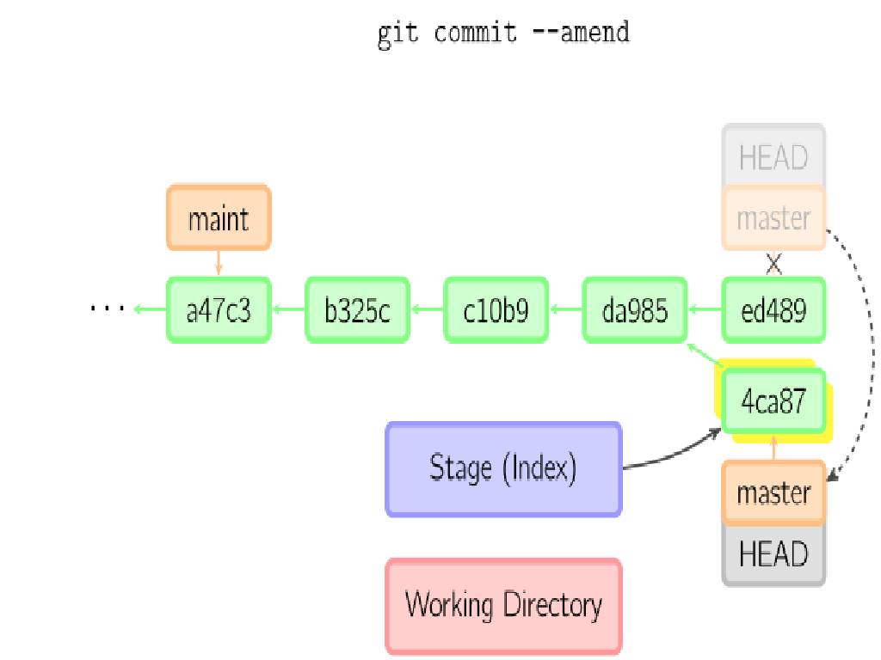
GIT command
Create new commit with same parent as current commit

Slide 16
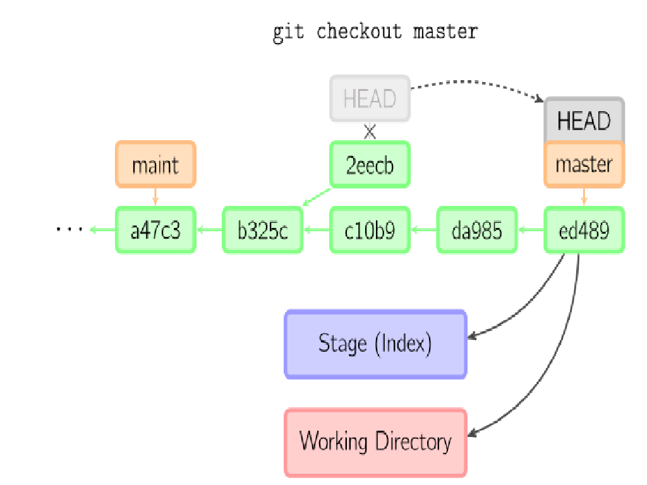
GIT command

Slide 17
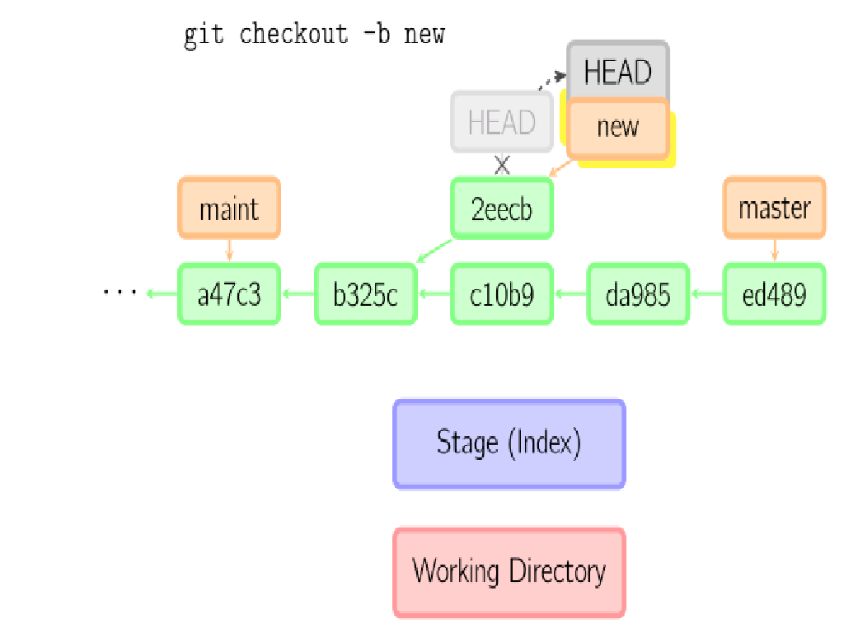
GIT command

Slide 18
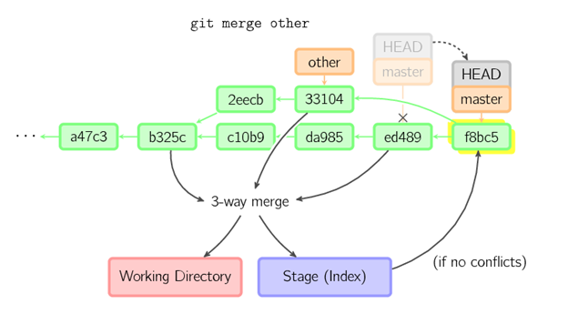
GIT command

Slide 19


GIT command
Git rebase: The final result for the source code is the same as with merge but the commit history is cleaner; the history appears to be linear.
Before rebase
After rebase

Slide 20
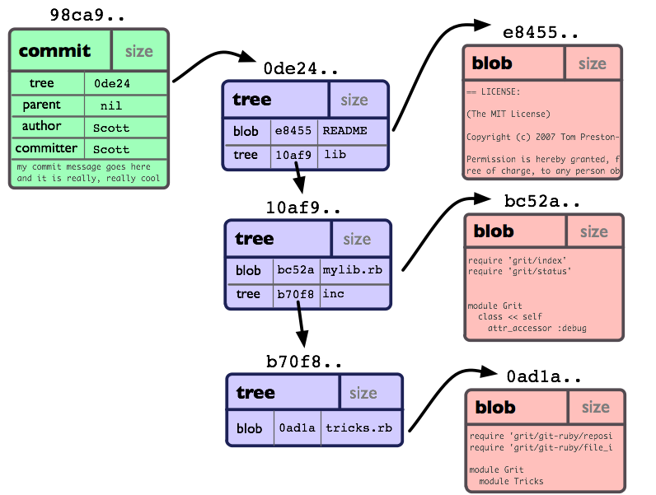
Insight Git

Slide 21
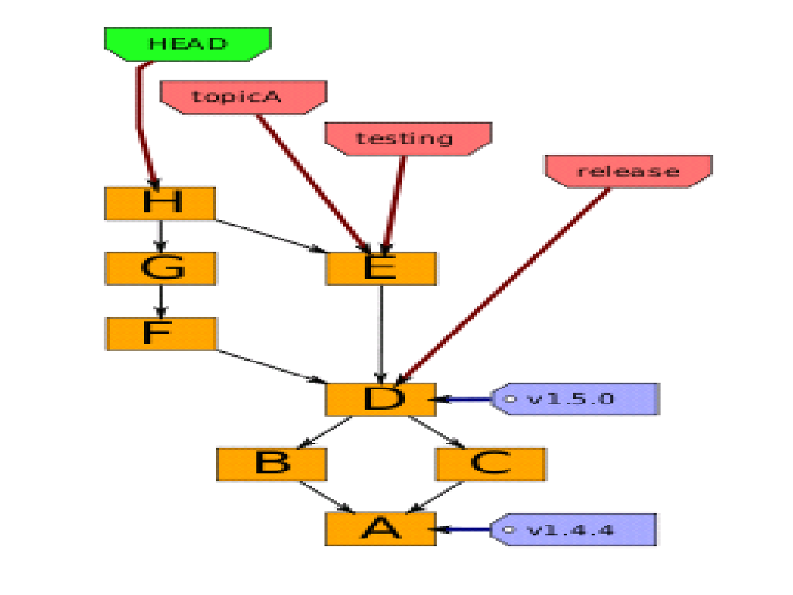
Insight GIT

Slide 22
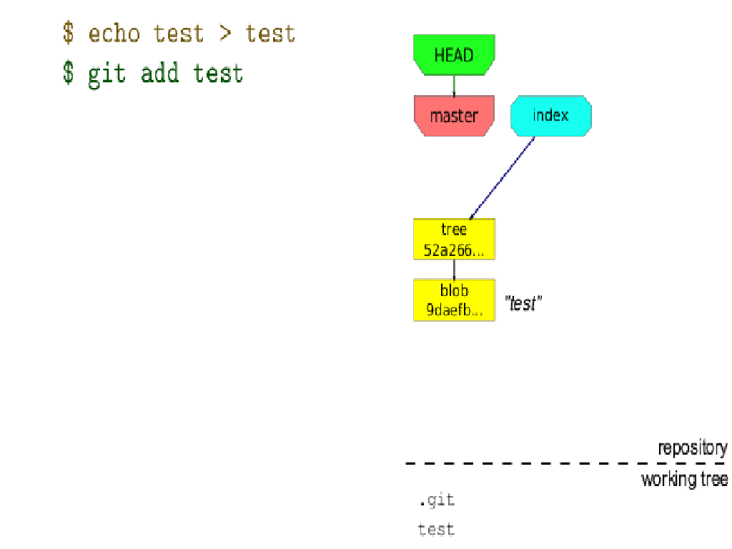
Insight GIT

Slide 23
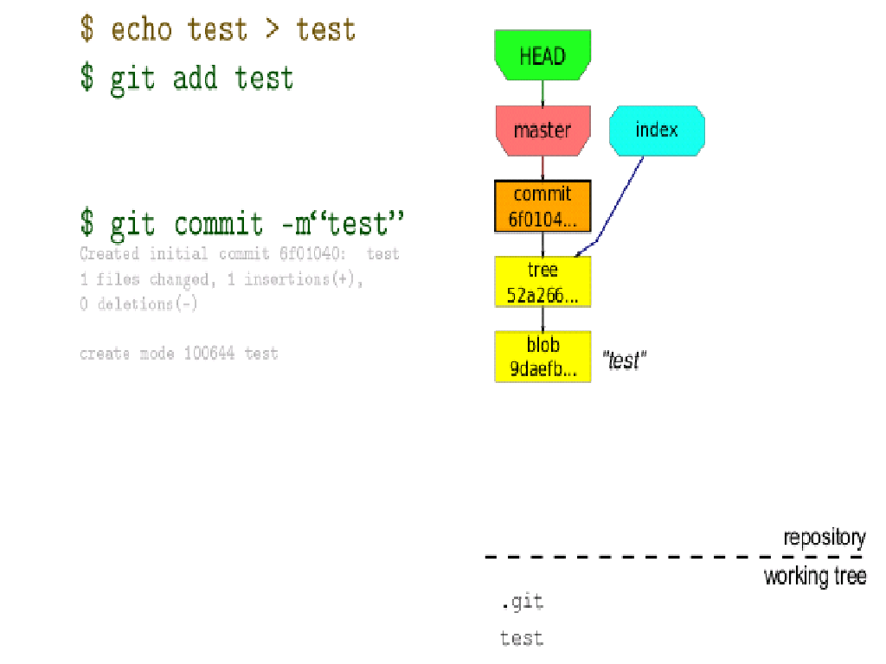
Insight GIT

Slide 24
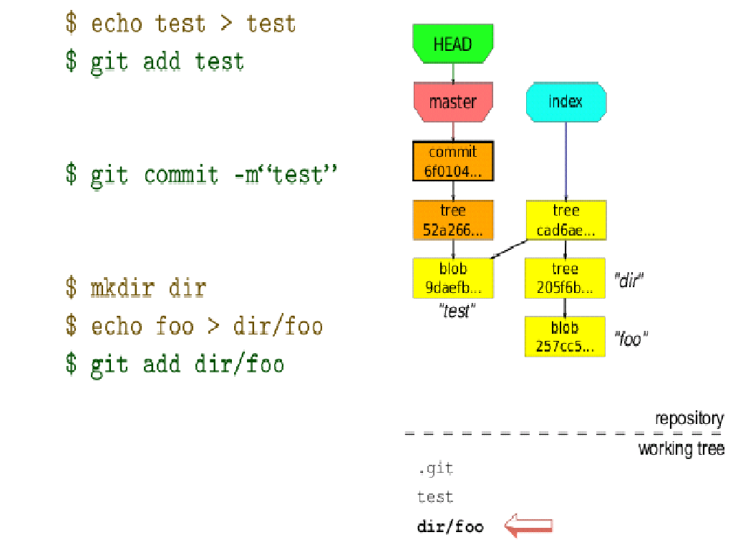
Insight GIT

Slide 25
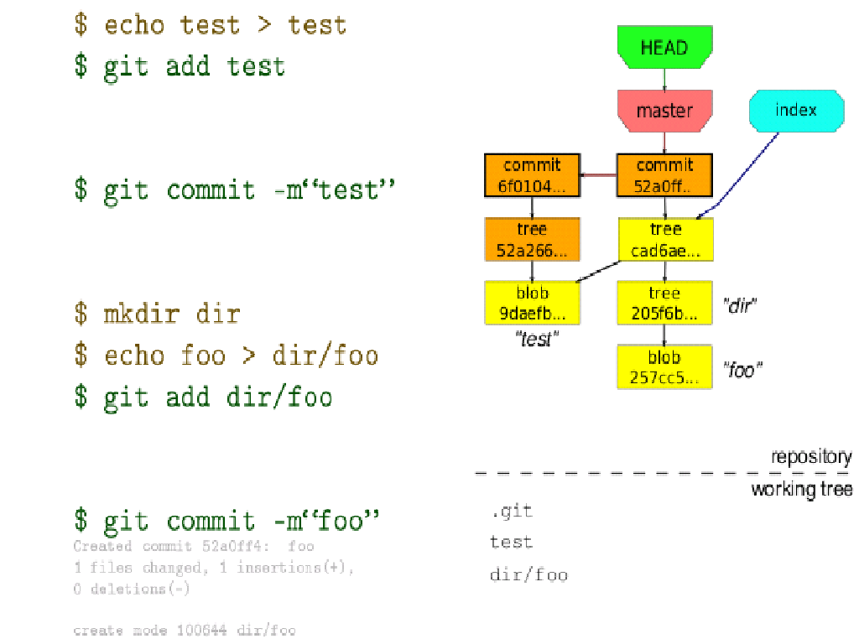
Insight GIT

Slide 26
Insight GIT
Log is commits tree
Branch is HEAD of tree, current branch will be move ahead when create commit, is simply a movable pointer to one of these commits
Tag is friend name of Hash.

Slide 27
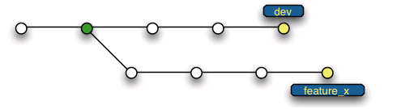
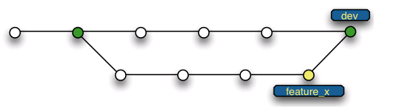
Branch strategies
For single dev:
$ git branch feature_x dev
$ git checkout feature_x
# add/commit... add/commit...
$ git checkout dev
$ git merge feature_x

Slide 28
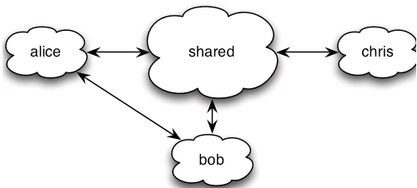
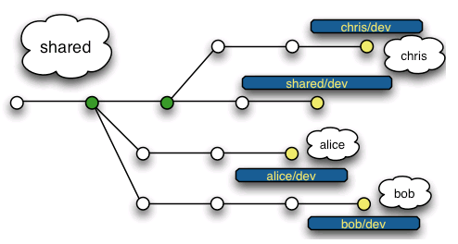
Branch strategies
For team:

Slide 29
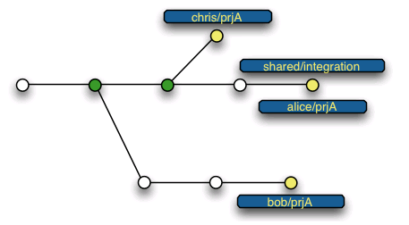
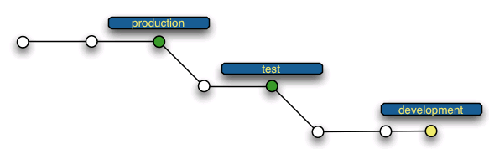
Branch strategies
For project:

Slide 30
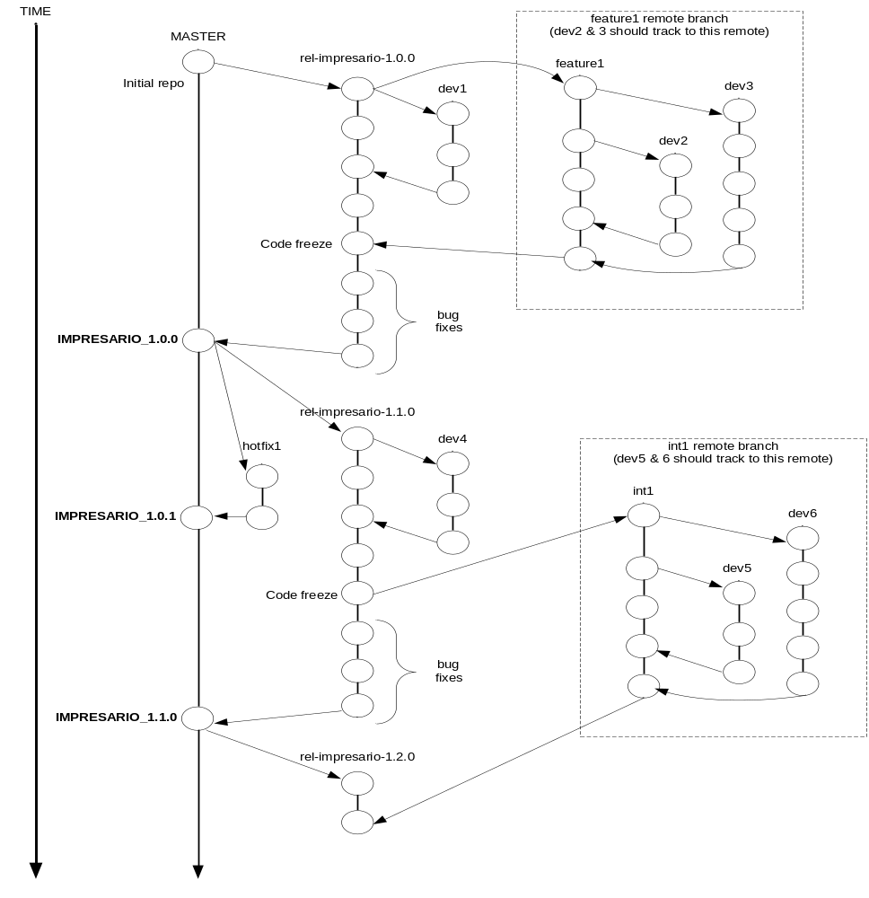
Branch strategies

Slide 31
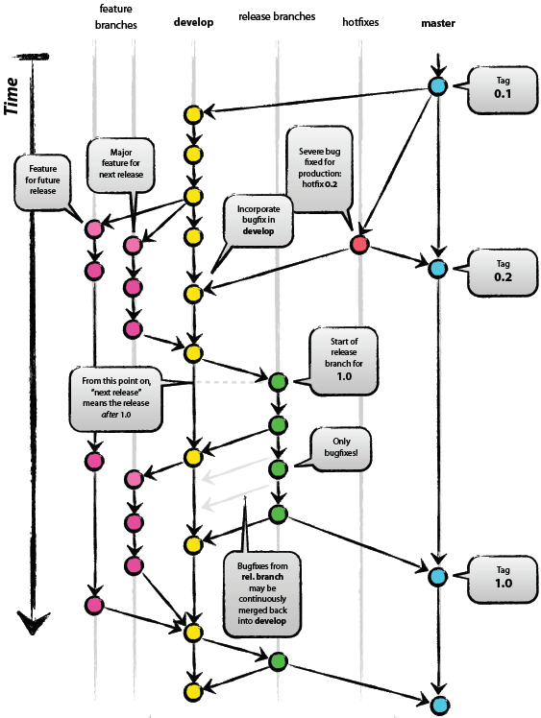
Branch strategies

Slide 32
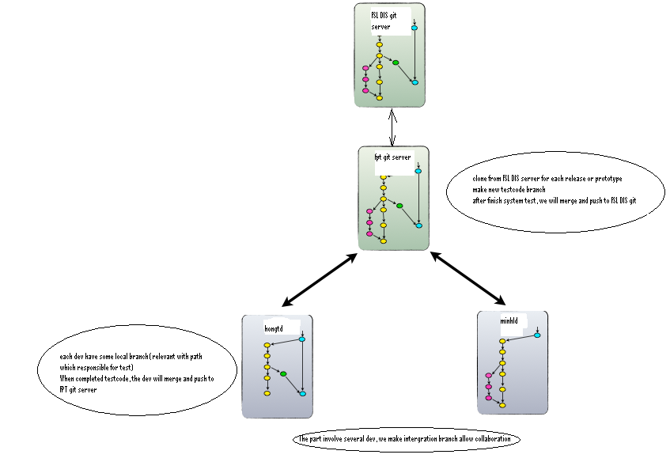
Branch strategies

Slide 33
Note
don’t use git pull, pls use git fetech then git rebase
Release branch naming convention:
rel-<project name>-<release version>
rel-impresario-1.0.0
Tag naming convention:
<project name>_<release version>
IMPRESARIO_1.0.0
4. Coding style check before commit

Slide 34
Note
5. Commit log format:
1st Line - ENGRxxxxxxxx<space>A short description used for patch file name
2nd Line – Blank
Remaining lines - A detailed description including origin of the patch if external.
Signed-off line which notes the author of the patch (not the reviewer).
6. Local development branches should be used for all development
7. Branches should be deleted after pushed to release branch to keep the Git as clean as possible
8. Merge should be use to track the changes=>
git merge –no-ff ( no fast forward)

Slide 35
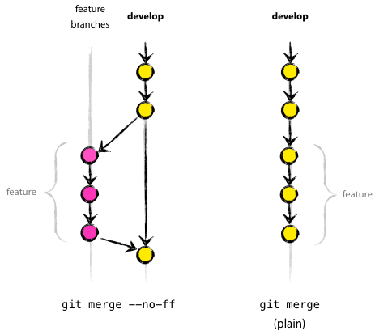
Note
--no-ff flag causes the merge to always create a new commit object, so this avoid losing information

Slide 36
        Q&A

